Slide 1
Microsoft Power Point
Presented by: Manal Asghar

Slide 2
Introduction & interface of PowerPoint :
Used for creating slideshows
Ideal for presentations, teaching, and reports

Slide 3
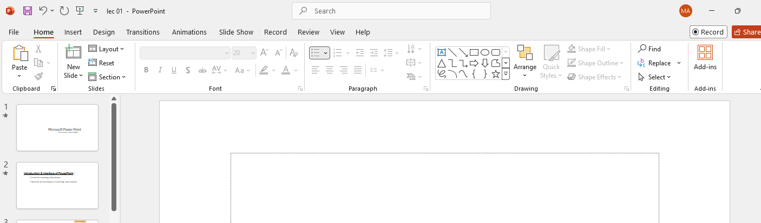
MS Power Point Interface
Quick access Toolbar
Tabs
Paragraph Group
Ribbon
Fonts Group
Add New Slide
Title Bar

Slide 4
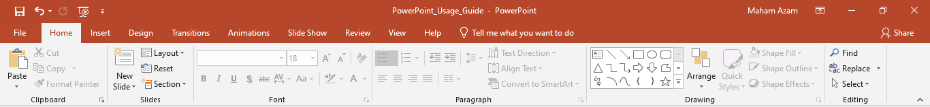
Creating a Presentation
Use Home Tab to:
Add new slides
Choose layout
Format text
Use Design Tab for:
Themes
Slide size
Background styles

Slide 5
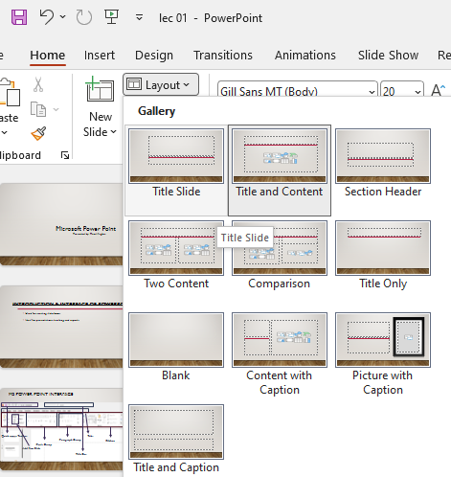
Slide layouts and design themes
Click on home tab
Click on Layout
These are all layout

Slide 6
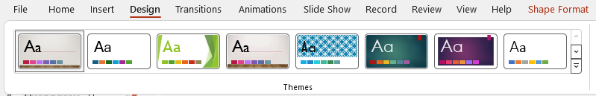
Slide design themes
Click on Design tab
These are Designs

Slide 7
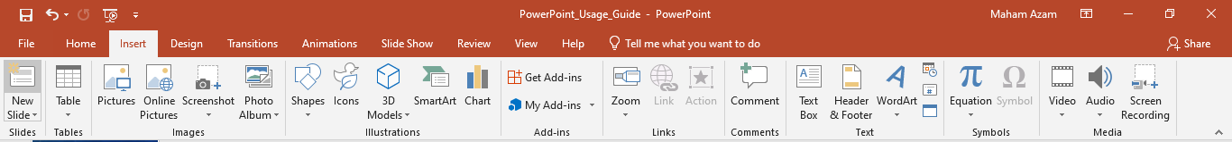
Creating a Photo Album
Go to Insert - Photo Album
Choose pictures from PC
Adjust layout and design
Click 'Create' to generate album

Slide 8
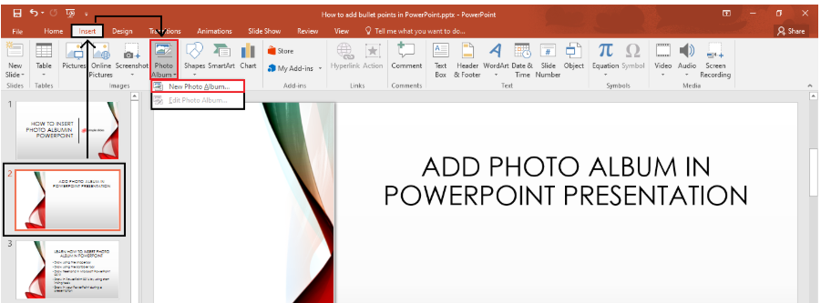

Slide 9
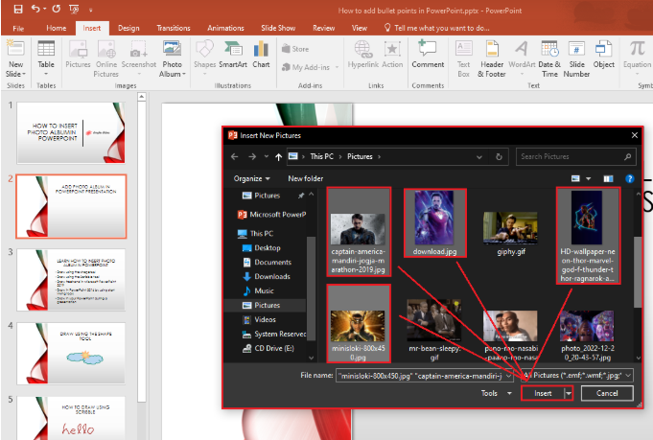

Slide 10
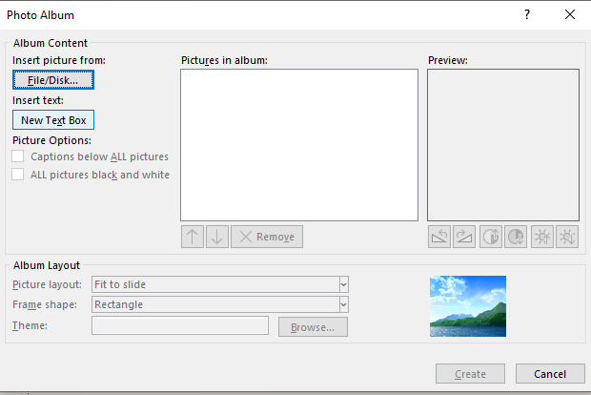

Slide 11
Transitions & Background Sound
Transitions Tab: Choose effects between slides
Add sound:
Go to Insert > Audio
Choose 'Audio on My PC'
Set to play in background
Transition Slide & Working
Add a slide between sections
Apply distinct transition (e.g., Fade)
Use Slide Sorter view for smooth flow

Slide 12
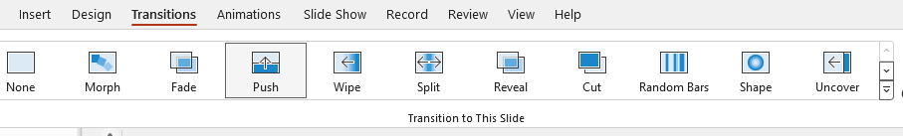
Using transitions
Click on Transition tab
These are transition to a single slide

Slide 13
Applying Animation
Go to Animations Tab
Select object (text/image)
Choose animation style
Use Animation Pane to control timing

Slide 14
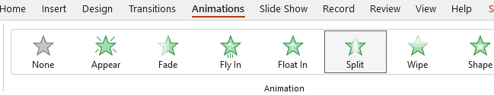
Using Animations
Click on Animation tab
2.Click on text which you want to animate
3.These are Animation to a text

Slide 15
Slide Master
View > Slide Master
Customize title, font, logo, layout
Saves time, applies design across all slides

Slide 16
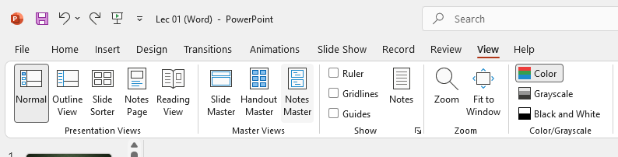
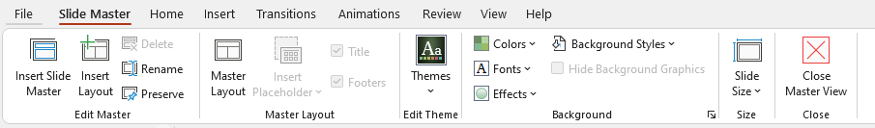
Click on view Tab
Slide master Tab
Click on Slide Master add tab Slide Master

Slide 17
Practical task
Create a 5-slide company overview presentation

